Slide 1
Mid-term Report: Cross-Domain Transfer Learning for Lithium-Ion Battery Capacity Prediction
Bridging the 6x C-rate Gap: Leveraging LFP Aging Patterns for High-Performance NCA Scenarios

Slide 2
Outline
Background & Strategic Significance
Literature & Theoretical Framework
Pipeline & Overall Architecture
Current Progress & Data Results
Follow-up work and expected results

Slide 3
Project Schedule

Slide 4
Outline
7. Methodology Overview — 你的方法总览(4模块管线图)
8. Module 1-2: Dynamic 3C Extraction & Peak Anchoring — 动态3C剥离 + ΔV峰锚定坐标
9. Module 3-4: Feature Reconstruction & PCHIP Labeling — 16×3+2特征 + PCHIP单调标签
10. Key Finding: Peak Anchoring Works — IC峰图(你那张早中晚期)、IC_8相关性0.96、跨工况锚定率
11. EFC Alignment — 用等效满循环对齐不同DOD(你的核心创新点)
12. Two-Stage Model — CNN编码器(SOH估计预训练)+ CNN-LSTM(早期→寿命)
13. Transfer Strategy — LFP→NCA:预训练+渐进式微调
14. Progress So Far — 已完成:286块电池数据管线、峰锚定验证、特征有效性
15. Future Work & Timeline — 未来:全量训练、曲线预测、NCA迁移(放Gantt图)

Slide 5
Outline
Background & Strategic Significance
Literature & Theoretical Framework
Pipeline & Overall Architecture
Current Progress & Data Results
Follow-up work and expected results

Slide 6
Background & Strategic Significance待修改
1. Industry Bottleneck
High Data Dependency: Traditional Deep Learning SOH models require massive, full-lifecycle data.
Prohibitive Time Costs: Testing new battery chemistries (e.g., NCA) takes months, driving up R&D expenses.
2. Cross-Domain Challenge
Domain Shift: LFP (flat plateau) vs. NCA (sloping profile).
Condition Gap: 3C (high polarization) vs. 0.5C (mild).
Model Failure: Traditional pure data-driven models fail catastrophically across different chemistries and C-rates.

Slide 7
Background & Strategic Significance
3. Our Solution: Physics-Informed Transfer Learning
Universal Physics: Anchor on Incremental Capacity (IC) peak deformation (Loss of Active Material, LAM).
CNN-LSTM Architecture: * Pre-train on abundant LFP (3C) data.
Fine-tune on sparse NCA (0.5C) data.
4. Strategic Impact (Vision)
Solves "Cold Start": Effectively decouples aging signatures from operating condition noise.
Few-Shot Prediction: Predicts the full lifespan of new battery materials using only early-cycle data.

Slide 8
Outline
Background & Strategic Significance
Literature & Theoretical Framework
Pipeline & Overall Architecture
Current Progress & Data Results
Follow-up work and expected results

Slide 9
Literature Review & Methodology待修改
Key Reference: Tsinghua & UC Berkeley (2025)
Liang et al., "Stochastic state of health estimation...", Journal of Energy Chemistry
Core Concept: Stochastic Segment Analysis
Problem: Full charge/discharge cycles are rare in real-world EV data.
Innovation: Extracting extremely narrow voltage windows (< 0.3V) anchored strictly at Incremental Capacity (IC) peaks.
Data processing results: Utilizing sequences like Q(V) and dQ(V) to capture the physical Loss of Active Material (LAM).
Our Adoption & Upgrade: * Implemented an ultra-narrow 0.12V dynamic window centered at Vpeak.
Generated a pure, decoupled 16x3 feature matrix independent of absolute voltage shift.

Slide 10
Literature Review & Methodology
Key Reference: Stanford & MIT (2019)
Severson et al., "Data-driven prediction of battery cycle life...", Nature Energy
Core Concept: Early Degradation Momentum
The Problem: Early-life batteries show near-zero capacity fade; traditional models cannot predict the "knee point" (sudden failure).
The Innovation: Using cross-cycle evolution (e.g., variance of $\Delta Q$) as an early predictor of lifespan.
Our Adoption & Upgrade: * Extracted the drift velocity of polarization ($\Delta V_{peak}$).
Shifted from static estimation to Sequence-to-Sequence (Seq2Seq) prediction, capturing "degradation inertia" from the first 100 cycles to forecast the entire lifespan.

Slide 11
Literature Review & Methodology
Bridging Electrochemistry and Deep Learning
How we merge the above theories into an End-to-End Transfer Learning pipeline:
1. Dynamic Alignment (Data Engineering):
Gaussian Smoothing & IC Tracking: Isolates the true electrochemical phase center.
PCHIP Interpolation: Reconstructs strictly monotonic, non-linear physical SOH labels from sparse checkup data.
2. Spatiotemporal Architecture (Deep Learning):
1D-CNN (Spatial): Extracts geometric collapse patterns from the $16 \times 3$ matrices.
LSTM (Temporal): Learns long-term aging acceleration across consecutive cycles.
3. Domain Adaptation (Transfer Strategy):
Injecting $V_{peak0}$ as a static domain anchor.
Enables Pre-train $\rightarrow$ Fine-tune migration from Source Domain (LFP, 3C) to Target Domain (NCA, 0.5C).

Slide 12
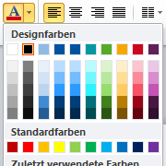
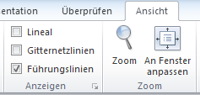
Literature Review & Methodology
Schriftarten und -größen dürfen nicht verändert werden
Die Farben sind voreingestellt und entsprechen dem RWTH-Styleguide
Eine sinnvolle Auswahl der im Styleguide definierten Farben ist in der Vorlage enthalten
Schriftfarbe ist Schwarz
Inhalt muss innerhalb der Führungslinien Platz finden
Bilder können an den Hilfslinien ausgerichtet werden
Führungslinien können im Ribbon „Ansicht“ ein- und ausgeschaltet werden

Slide 13
Literature Review & Methodology
Schriftarten und -größen dürfen nicht verändert werden
Die Farben sind voreingestellt und entsprechen dem RWTH-Styleguide
Eine sinnvolle Auswahl der im Styleguide definierten Farben ist in der Vorlage enthalten
Schriftfarbe ist Schwarz
Inhalt muss innerhalb der Führungslinien Platz finden
Bilder können an den Hilfslinien ausgerichtet werden
Führungslinien können im Ribbon „Ansicht“ ein- und ausgeschaltet werden

Slide 14
Outline
Background & Strategic Significance
Literature & Theoretical Framework
Pipeline & Overall Architecture
Current Progress & Data Results
Follow-up work and expected results

Slide 15
Pipeline & Overall Architecture
Our system operates through a sequential, 3-stage blueprint, transforming raw noisy data into cross-domain lifespan predictions:
Stage 1: Physics-Informed Data Engine
Dynamic extraction of 3C/0.5C cycles and Gaussian phase-centering.
Output: Decoupled 50-dimensional feature sequences.
Stage 2: Spatiotemporal Modeling
Capturing spatial geometric collapse (LAM) and temporal degradation momentum.
Output: Predicted $\Delta SOH$ trajectory.
Stage 3: Domain Adaptation
Migrating learned physical laws from Source (LFP, 3C) to Target (NCA, 0.5C).
Output: Zero-to-few-shot lifespan prediction for new battery chemistries.

Slide 16
Pipeline & Overall Architecture
Decoupling Chemistry from Operation (特征解耦与重构)
How we translate raw battery data into DNN-ready physical tensors:
1. Dynamic Filtering & Monotonic Labeling:
Adaptive $C_{now}$ tracking for pure constant-current segments.
PCHIP Interpolation: Enforcing strict thermodynamic monotonicity for sparse SOH checkups.
2. The Relative Phase Coordinate ($16 \times 3$ Matrix):
Anchoring at the Incremental Capacity (IC) peak ($V_{peak}$).
Extracting $Q, \Delta Q, IC$ within an ultra-narrow 0.12V window to capture pure spatial deformation.
3. Domain Anchors (The 2 Scalars):
$V_{peak0}$: Static chemistry ID (e.g., LFP vs. NCA).
$\Delta V_{peak}$: Dynamic polarization drift (LLI proxy).

Slide 17
Pipeline & Overall Architecture
The CNN-LSTM Hybrid Architecture
Merging spatial pattern recognition with temporal sequence forecasting:
1. 1D-CNN (The "Shape" Extractor):
Processes the $16 \times 3$ matrix to learn the universal geometry of peak collapse.
🔒 Transfer Strategy: Frozen during NCA fine-tuning to preserve domain-invariant physical rules.
2. LSTM (The "Momentum" Tracker):
Processes sequences of consecutive cycles (e.g., first 100 cycles).
Accumulates cross-cycle degradation inertia (decay velocity & acceleration).
🔓 Transfer Strategy: Unfrozen during NCA fine-tuning to adapt to the specific "0.5C slow-decay" rhythm.
3. Fully Connected Decoder:
Injects $V_{peak0}$ and outputs the future $\Delta SOH$ trajectory across the entire lifespan.

Slide 18
Outline
Background & Strategic Significance
Literature & Theoretical Framework
Pipeline & Overall Architecture
Current Progress & Data Results
Follow-up work and expected results

Slide 19
Current Progress & Data Results
Folien aus anderen Präsentation können in die neue Präsentation kopiert werden
Danach „Zurücksetzen“
Unbedingt Fußzeilen entfernen und wieder neu setzen!
Die letzte Seite soll eine Kopie der Titelfolie sein
Bildet für eine Diskussion einen neutraleren Hintergrund
Titel des Vortrags und Name des Vortragenden sind oftmals ganz hilfreich

Slide 20
Current Progress & Data Results
Folien aus anderen Präsentation können in die neue Präsentation kopiert werden
Danach „Zurücksetzen“
Unbedingt Fußzeilen entfernen und wieder neu setzen!
Die letzte Seite soll eine Kopie der Titelfolie sein
Bildet für eine Diskussion einen neutraleren Hintergrund
Titel des Vortrags und Name des Vortragenden sind oftmals ganz hilfreich

Slide 21
Current Progress & Data Results
Folien aus anderen Präsentation können in die neue Präsentation kopiert werden
Danach „Zurücksetzen“
Unbedingt Fußzeilen entfernen und wieder neu setzen!
Die letzte Seite soll eine Kopie der Titelfolie sein
Bildet für eine Diskussion einen neutraleren Hintergrund
Titel des Vortrags und Name des Vortragenden sind oftmals ganz hilfreich

Slide 22
Outline
Background & Strategic Significance
Literature & Theoretical Framework
Pipeline & Overall Architecture
Current Progress & Data Results
Follow-up work and expected results

Slide 23
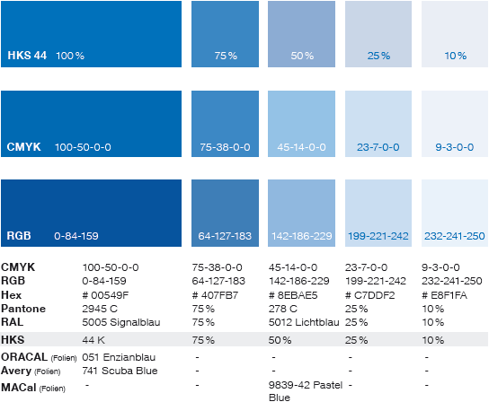
Follow-up work and expected results

Slide 24
Follow-up work and expected results

Slide 25
Follow-up work and expected results

Slide 26
Follow-up work and expected results

Slide 27
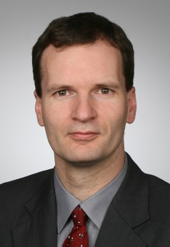



Eintrag: Autor
Eintrag: Partner, wenn vorhanden
Tel.: +49 241 80-96977
dsa@isea.rwth-aachen.de
batteries@isea.rwth-aachen.de

Slide 28
Mid-term Report: Cross-Domain Transfer Learning for Lithium-Ion Battery Capacity Prediction
Bridging the 6x C-rate Gap: Leveraging LFP Aging Patterns for High-Performance NCA Scenarios

